Slide 1
Resilience and Risk in Supply Chains
Advisory Committee on Supply Chain Competitiveness,
U.S. Department of Commerce | International Trade Administration
April 16, 2015
Dr. Sue Helper
Chief Economist

Slide 2
Agenda
Resilience and supply chain risk
Thinking about variance of returns is new for us—would like your insights
What is the value of resilience?
Example: valuing reduced variance due to reduced lead time

Slide 3
Resilience
Definition:
“the ability to prepare for and adapt to changing conditions and withstand and recover rapidly from disruptions”
(Source: Presidential Policy Directive 8)

Slide 4
Resilience: A Federal Strategic Policy Objective
Presidential Policy Directive 8 calls for
“strengthening the security and resilience
of the United States through systematic preparation for the
threats that pose the greatest risk to the security of the nation
including acts of terrorism, cyber attacks,
pandemics and catastrophic natural disasters.”

Slide 5
Economic Costs of Natural Disasters
According to the NOAA’s National Climatic Data Center U.S. sustained
178 weather and climate disasters since 1980 where overall damages exceeded $1 billion
Total cost of these 178 events > $1 trillion
Examples:
Hurricane Katrina in 2005:
$151 billion in costs, 1,833 deaths
Hurricane Sandy in 2010
$67 billion in costs, 159 deaths

Slide 6
Expected Returns on Investment
For any investment there is an expected return:
E(x)= p(payoff in good state)+(1-p)(payoff in bad state)
bad state-when an undesirable outcome occurs
disasters can cause very bad payoffs even if the probability they occur is low

Slide 7
Investment beta
β – a measure how closely an investment moves with the market
The technical term for this is “risk correlation”
You want to diversify your portfolio and not have all high β investments
Why? So you don’t lose it all in a shock or recession

Slide 8
Investments in resilience have a low β
Disasters hurt the firm (and may cause the whole stock market to go down), so all investments highly correlated with good outcomes for the firm and the rest of the market will go down
Investments in resilience are countercyclical: they allow communities and businesses to bounce back after a disaster (see IKEA example next)

Slide 9
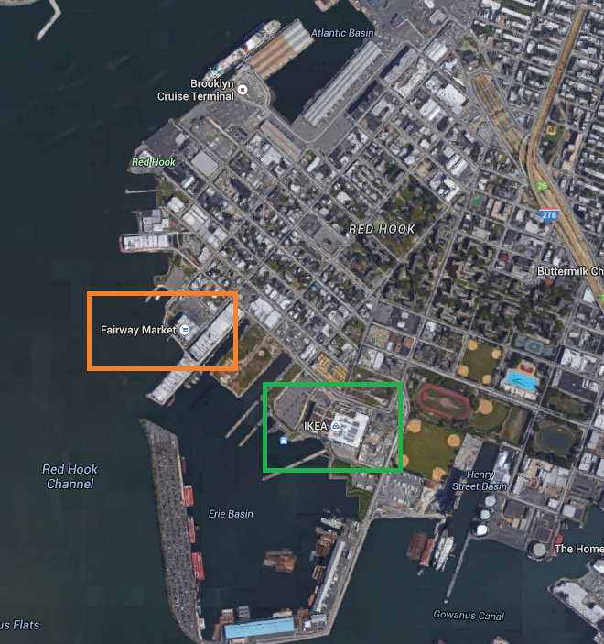
Example: Brooklyn Stores in Superstorm Sandy
Fairway Market
Located in 19th century warehouse
Closed for 4 months while entire inventory ruined by flood was restocked
Bad for business and the community
IKEA
Built to be flood resistant on pilings with emergency generator
Resilience allowed it to become FEMA distribution center
Good for business and the community
Source: http://resiliencedividend.org/ Image source: http://maps.google.com

Slide 10
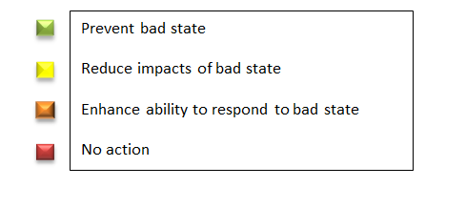
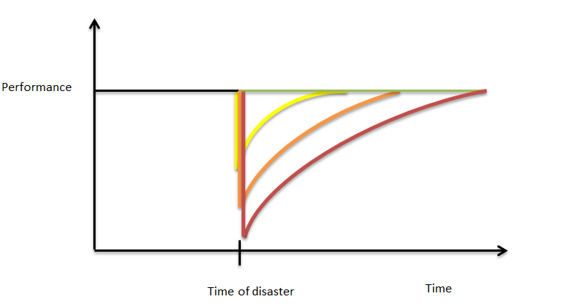
Recovery by Different States of Preparation

Slide 11
Ways to invest in Resilience
Prevent “bad state”
Collectively fight climate change
Reduce impacts of “bad state”
Upfront investments, example: IKEA using pilings and generator
Enhance ability to respond to “bad state”
Shorten recovery time by not having a far-flung supply chain
Do nothing

Slide 12
Enhancing Response Ability and Time
Far-flung supply chains mean more difficulty in responding to any problem—not just natural disasters
ESA has developed a tool to asses the costs of a far-flung supply chain such as
shipping
lead time
inventory costs

Slide 13
acetool.commerce.gov

Slide 14
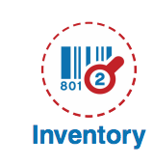
Key ideas on Costs of a Far Flung Supply Chain
When suppliers are far away, they must produce to a forecast, rather than to a known order. As lead time increases, the possible range of demand levels becomes wider.
A product’s scrap value is usually far less than its full price
Thus, firms want to ensure that they do not have a “stock out”, so they order much more than they expect to sell
Often they order > twice median demand → huge waste (and outlet malls)
Producing locally to order avoids these costs
Savings from offshoring may need to be > 20% to offset the cost of uncertainty in forecasts with long lead times

Slide 15
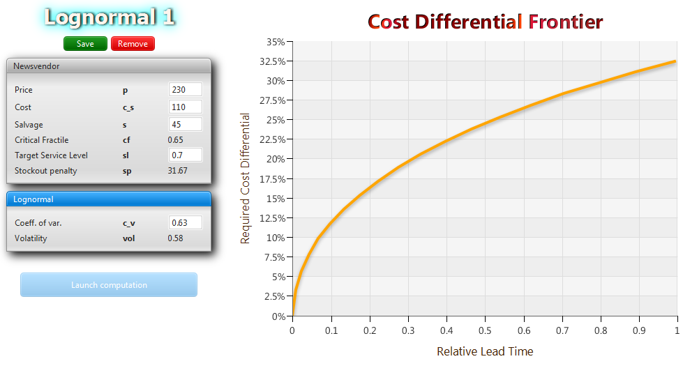
Cost Differential Frontier
If relative lead time = 1 (a very long supply chain – e.g., China), cost savings would have to be 32.5% to make up for the cost of demand forecast uncertainty!

Slide 16
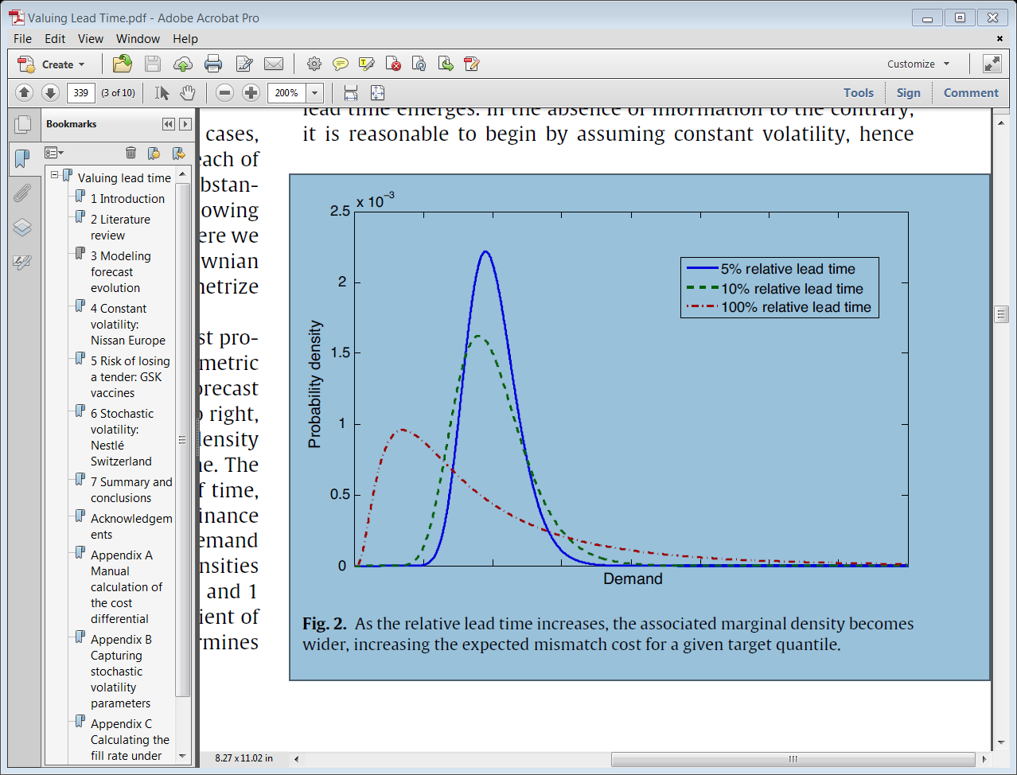

Slide 17
Reactions
How does your firm think about investment and disaster risks?
How much do you weigh worst case scenarios (“bad state”)?
How do you think about supply chain risks?
Is the ACE framework useful? How could it be improved?
Other reactions?

